Slide 1
Gradient Descent and backpropagation
How neural networks learn

Slide 2
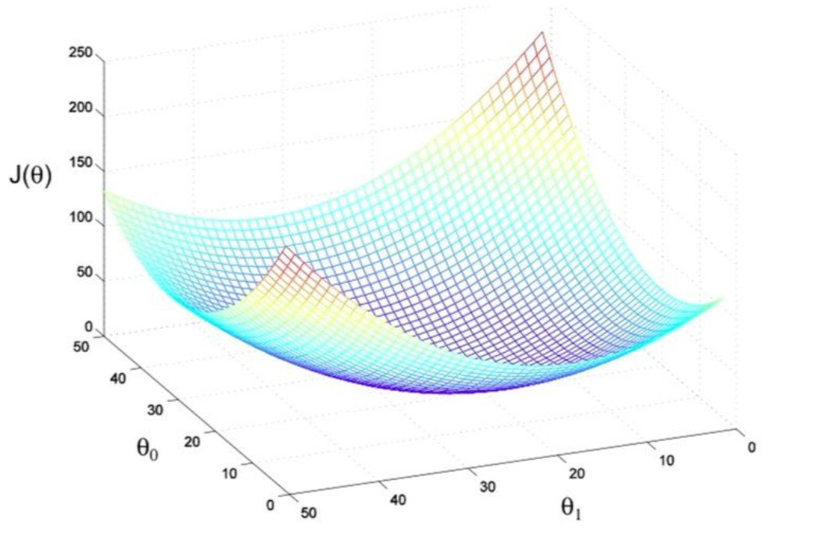
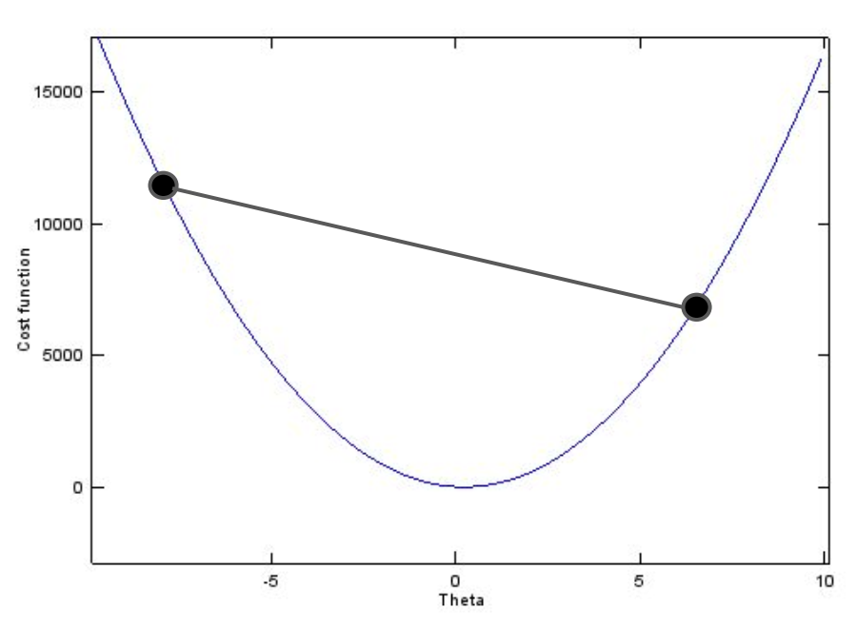
Back to the learning problem: reducing the cost function
Fitting a machine learning model means finding the best values of its parameters.
The best model is that whose parameter values minimize the cost function
Determine the set of parameters (weights + biases) that minimize the errors the model makes
Cost function of one parameter
Cost function of two parameter

Slide 3
Back to the learning problem: reducing the cost function
Ideally the cost function is convex
only one global optimum, which is the global minimum
Closed form solution
Compute the derivative of the model equation and find the point where it is 0 (exact solution).
Multiple variables: partial derivatives, and solve an equation system to find where all are 0 simultaneously
Difficult to solve if the model equation is complicated, has many variables (large equation system) or is not derivable.
Alternative solution :
Use an optimization algorithm such as gradient descent (also valid for non-convex functions!)

Slide 4
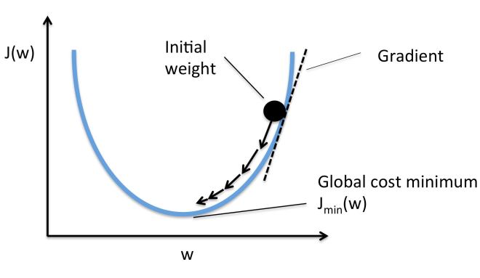
Gradient Descent
Gradient Descent (GD) is an optimization algorithm used to minimize some function by iteratively moving in the direction of steepest descent as defined by the negative of the gradient
Using the GD optimization algorithm, the weights are updated incrementally after each epoch

Slide 5
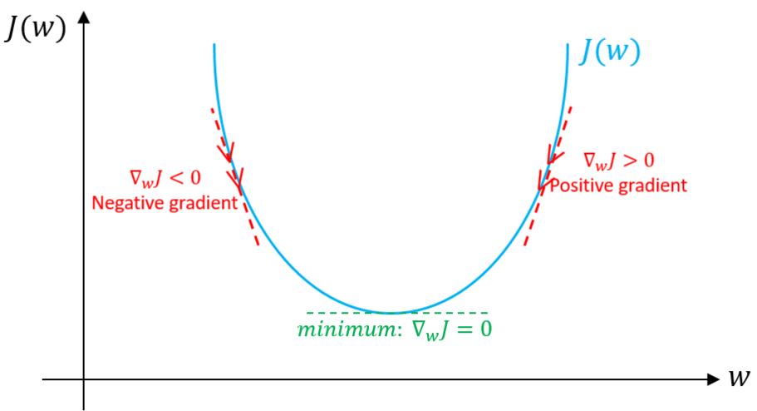
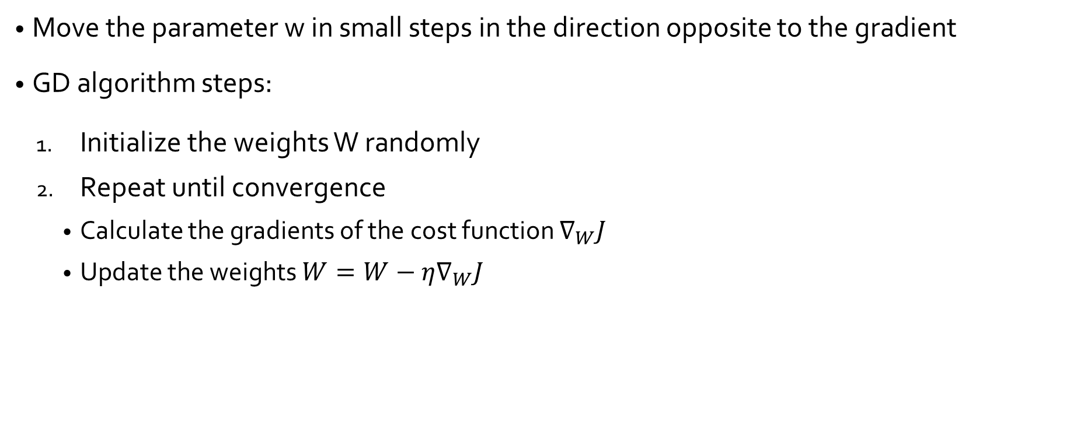
Gradient Descent
Move the parameter w in small steps in the direction opposite to the gradient
GD algorithm steps:
Initialize the weights W randomly
Repeat until convergence
Calculate the gradients of the cost function $∇_{W}J$
Update the weights $W=W−η∇_{W}J$

Slide 6
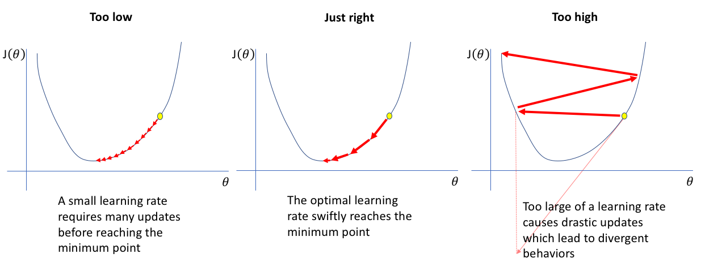
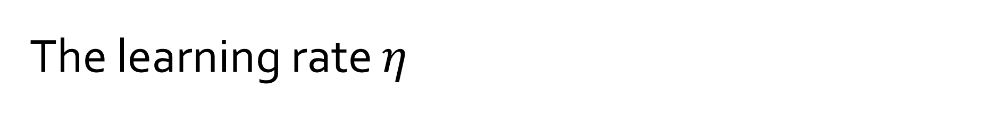
The learning rate $η$
The size of the steps we take to reach a minimum.
High values of η may overshoot the minimum, and very low values will reach the minimum very slowly.

Slide 7
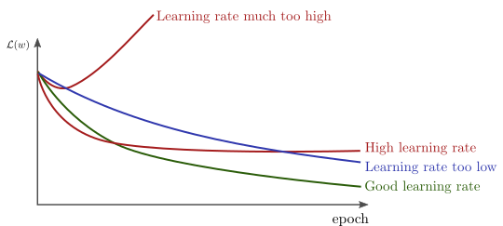
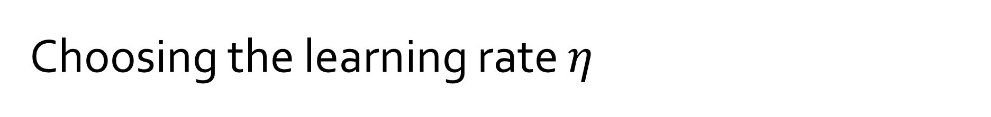
Choosing the learning rate $η$
Manually trough trial and error :
start with a small value such as 0.1, 0.01 or 0.001 and adapt it based on whether the cost function is reducing very slowly (increase learning rate) or is exploding / being erratic (decrease learning rate).
Some GD optimizers can be used to find a suitable learning rate automatically
Adam optimizer
AdaGrad

Slide 8
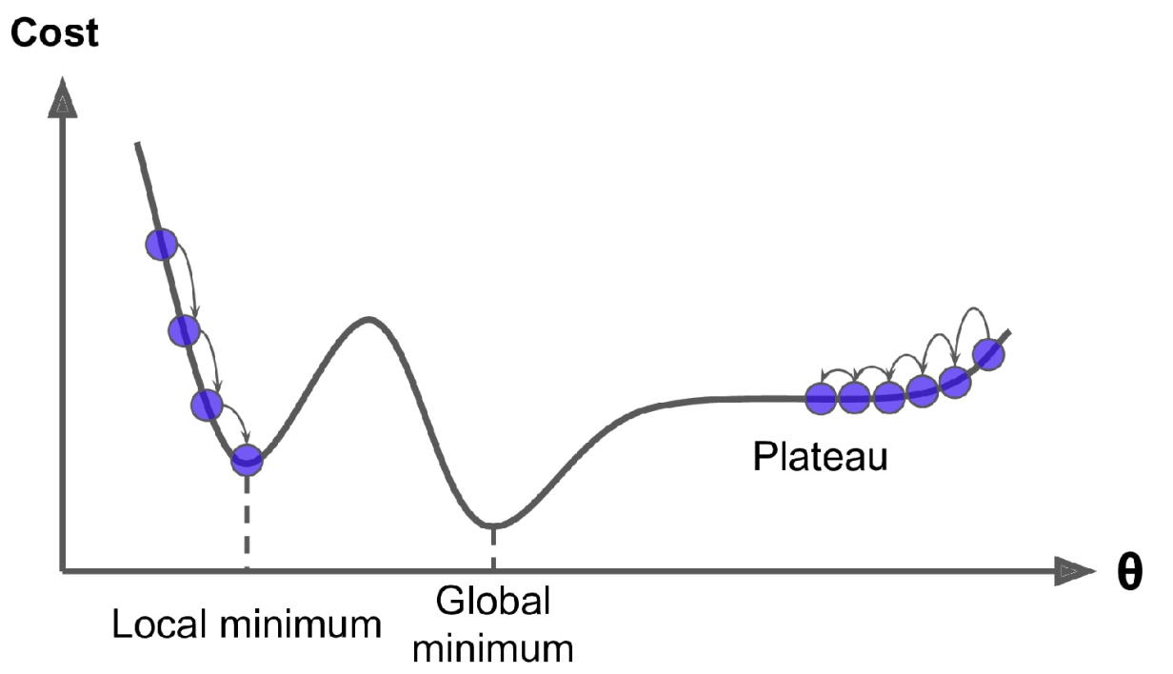
Gradient Descent pitfalls
Non convexity
GD takes a long time to cross the plateau
May never reach the global minimum if it stops early
Converge to the local minimun
Does not go to the global minimum

Slide 9
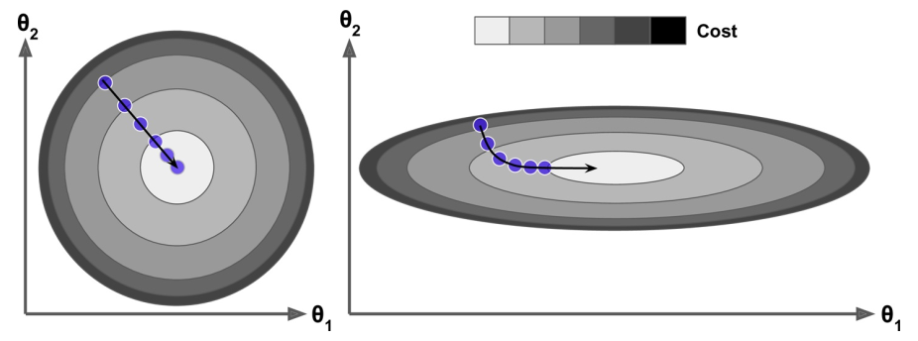
Gradient Descent and feature scaling
GD converges much faster when features are scaled
With feature scaling
Without feature scaling

Slide 10
Types of Gradient Descent
Batch Gradient Descent (a.k.a Vanilla GD)
Calculates error for each example. Model weights are updated only after an epoch
Terribly slow on very large training sets
Stochastic Gradient Descent
Iterates over each example while updating the weights
Frequent updates can be computationally more expensive
Mini-batch Gradient Descent
A combination of stochastic GD and Batch GD
Splits data into batches then performs update on batches
Balances between the computatinal efficiency of batch GD and robustness of stochastic GD
Notes:
More on https://machinelearningmastery.com/gentle-introduction-mini-batch-gradient-descent-configure-batch-size/

Slide 11
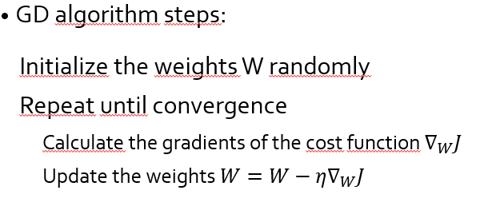
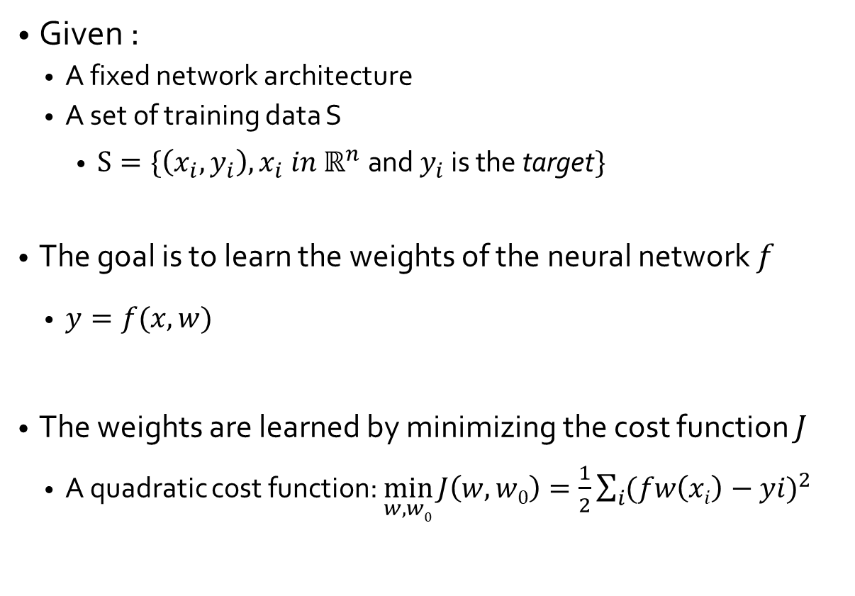
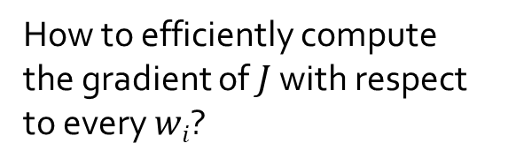
Training a Neural Network
Given :
A fixed network architecture
A set of training data S
$S=\{\left(x_{i},y_{i}\right),x_{i} in ℝ^{n} \text{and} y_{i} \text{is} \text{the} \text{t}\text{arget}\}$
The goal is to learn the weights of the neural network $f$
$y=f(x,w)$
The weights are learned by minimizing the cost function $J$
A quadratic cost function: $\min_{w,w0}{J\left(w,w0\right)=\frac{1}{2}\sum_{i}{{(fw\left(xi\right)−yi)}^{2}}}$
Using GD
How to efficiently compute the gradient of $J$ with respect to every $wi$?

Slide 12
Backpropagation
Short for "backward propagation of errors”
Backpropagation is a method for computing the partial derivatives of a loss function with respect to the parameters of a neural network
“reverse-mode automatic differentiation”
It a technique for adapting the weights or parameters of a nonlinear system by using derivatives.
It is the key algorithm that makes training deep models computationally tractable

Slide 13



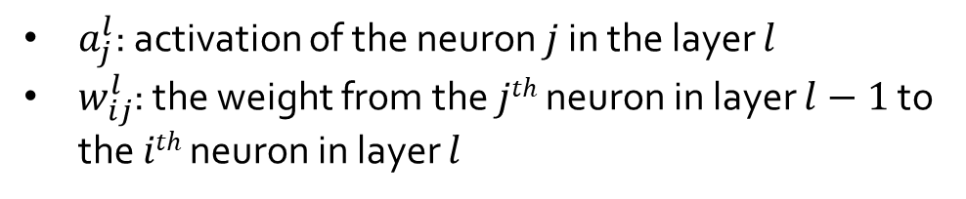

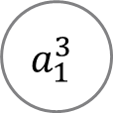




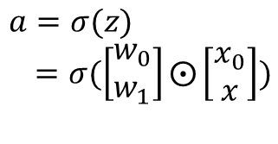
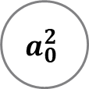

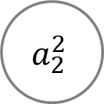



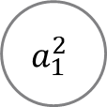



Backpropagation
$a_{j}^{l}$: activation of the neuron $j$ in the layer $l$
$w_{ij}^{l}$: the weight from the $jth$ neuron in layer $l−1$ to the $ith$ neuron in layer $l$
x₀
$$a_{0}^{2}$$
$$w_{10}^{2}$$
$$w_{10}^{3}$$
$$w_{20}^{2}$$
x₀
x₁
$$a_{1}^{2}$$
$$a_{1}^{3}$$
$$w_{0}$$
$$w_{11}^{2}$$
$$w_{11}^{3}$$
$$y$$
$$z$$
$$σ$$
$$a=σ(z)$$
$=σ(\left[\begin{matrix}w_{0} \\ w_{1}\end{matrix}\right]⨀\left[\begin{matrix}x_{0} \\ x\end{matrix}\right])$
$$w_{21}^{2}$$
x
$$w_{1}$$
x₂
$$w_{12}^{2}$$
$$a_{2}^{2}$$
$$w_{12}^{3}$$
$$w_{22}^{2}$$
$$z_{j}^{l}=\sum_{i}{w_{ji}^{l}a_{j}^{l−1}}$$
$$a_{j}^{l}=σ(z_{j}^{l})$$
Input Layer
(layer 1)
Hidden Layer
(layer 2)
Output Layer
(layer 3)

Slide 14
Backpropagation
Initialize weights
x₀
$$a_{0}^{2}$$
Initialization: Initialize the network connections with random weights
An important step otherwise training will fail
Initializing all the weights with zeros leads the neurons to learn the same features during training.
$$w_{10}^{2}$$
$$w_{10}^{3}$$
$$w_{20}^{2}$$
x₁
$$w_{11}^{2}$$
$$a_{1}^{2}$$
$$a_{1}^{3}$$
$$w_{11}^{3}$$
$$y$$
$$w_{21}^{2}$$
x₂
$$w_{12}^{2}$$
$$a_{2}^{2}$$
$$w_{12}^{3}$$
$$w_{22}^{2}$$
Input Layer
(layer 1)
Hidden Layer
(layer 2)
Output Layer
(layer 3)

Slide 15






Backpropagation
Forward Propagation
Forward Propagation: compute values from inputs to output
Starting from the first layer, for every neuron in layer n, compute the weighted sum of the output from every connected neuron in layer n - 1. Add the bias and apply activation.
Proceed to layer n + 1 using the output values from layer n as input.
Carry on layer by layer until you reach the last layer. The output from those neurons will give y.
x₀
$$a_{0}^{2}$$
$$w_{10}^{2}$$
$$w_{10}^{3}$$
$$w_{20}^{2}$$
x₁
$$w_{11}^{2}$$
$$a_{1}^{2}$$
$$a_{1}^{3}$$
$$w_{11}^{3}$$
$$y$$
$$w_{21}^{2}$$
x₂
$$w_{12}^{2}$$
$$a_{2}^{2}$$
$$w_{12}^{3}$$
$$w_{22}^{2}$$
Input Layer
(layer 1)
Hidden Layer
(layer 2)
Output Layer
(layer 3)

Slide 16
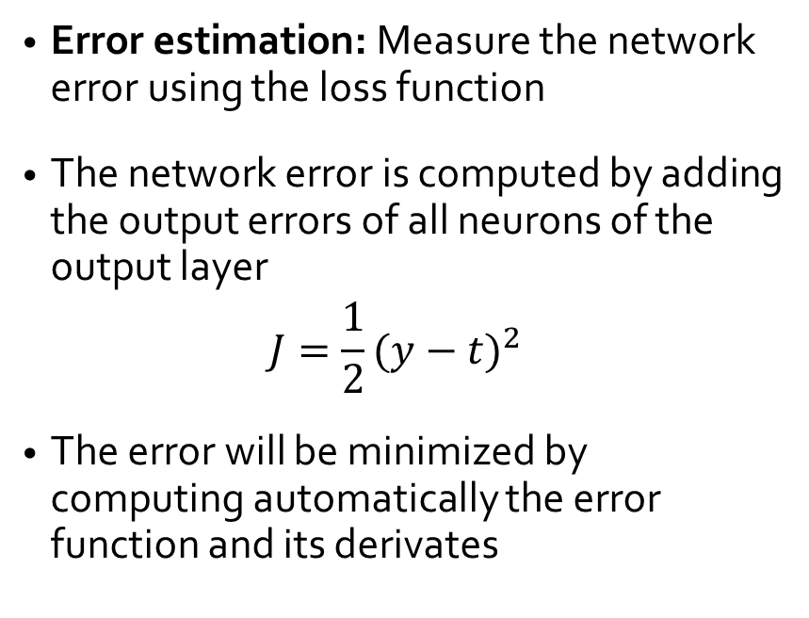
Backpropagation
Compute output error
x₀
$$a_{0}^{2}$$
Error estimation: Measure the network error using the loss function
The network error is computed by adding the output errors of all neurons of the output layer
$$J=\frac{1}{2}{(y−t)}^{2}$$
The error will be minimized by computing automatically the error function and its derivates
$$w_{10}^{2}$$
$$w_{10}^{3}$$
$$w_{20}^{2}$$
x₁
$$w_{11}^{2}$$
$$a_{1}^{2}$$
$$a_{1}^{3}$$
$$w_{11}^{3}$$
$$y$$
$$w_{21}^{2}$$
x₂
$$w_{12}^{2}$$
$$a_{2}^{2}$$
$$w_{12}^{3}$$
$$w_{22}^{2}$$
Input Layer
(layer 1)
Hidden Layer
(layer 2)
Output Layer
(layer 3)

Slide 17
Backpropagation
Backward propagation
x₀
$$a_{0}^{2}$$
Backward propagation: propagate the error term back
Starting from the output layer, move backwards and compute the error for each neuron in each layer
The gradient of the error function is computed and used to correct the initial weights.
$$w_{10}^{2}$$
$$w_{10}^{3}$$
$$w_{20}^{2}$$
x₁
$$w_{11}^{2}$$
$$a_{1}^{2}$$
$$a_{1}^{3}$$
$$w_{11}^{3}$$
$$y$$
$$w_{21}^{2}$$
x₂
$$w_{12}^{2}$$
$$a_{2}^{2}$$
$$w_{12}^{3}$$
$$w_{22}^{2}$$
Input Layer
(layer 1)
Hidden Layer
(layer 2)
Output Layer
(layer 3)

Slide 18
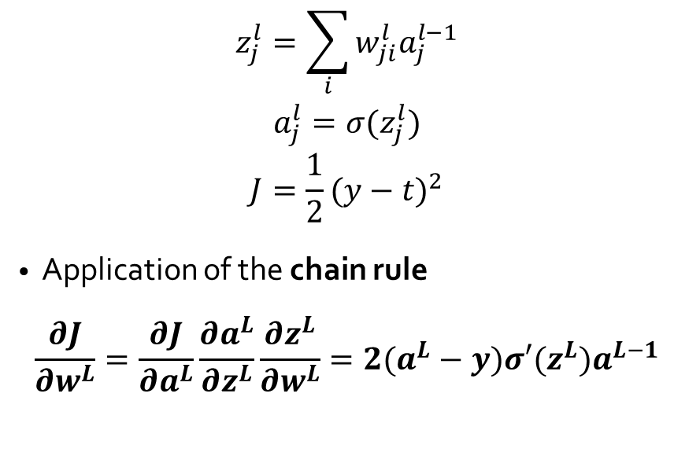
Gradients for the output layer
$$z_{j}^{l}=\sum_{i}{w_{ji}^{l}a_{j}^{l−1}}$$
$$a_{j}^{l}=σ(z_{j}^{l})$$
$$J=\frac{1}{2}{(y−t)}^{2}$$
Application of the chain rule
$$\frac{∂J}{∂w^{L}}=\frac{∂J}{∂a^{L}}\frac{∂a^{L}}{∂z^{L}}\frac{∂z^{L}}{∂w^{L}}=2(a^{L}−y)σ′(z^{L})a^{L−1}$$
x₀
$$a_{0}^{2}$$
$$w_{10}^{2}$$
$$w_{10}^{3}$$
$$w_{20}^{2}$$
x₁
$$w_{11}^{2}$$
$$a_{1}^{2}$$
$$a_{1}^{3}$$
$$w_{11}^{3}$$
$$y$$
$$w_{21}^{2}$$
x₂
$$w_{12}^{2}$$
$$a_{2}^{2}$$
$$w_{12}^{3}$$
$$w_{22}^{2}$$
Updating the weights in the output layer depends on the cost function and the weights connected to it
Input Layer
(layer 1)
Hidden Layer
(layer 2)
Output Layer
(layer 3)

Slide 19
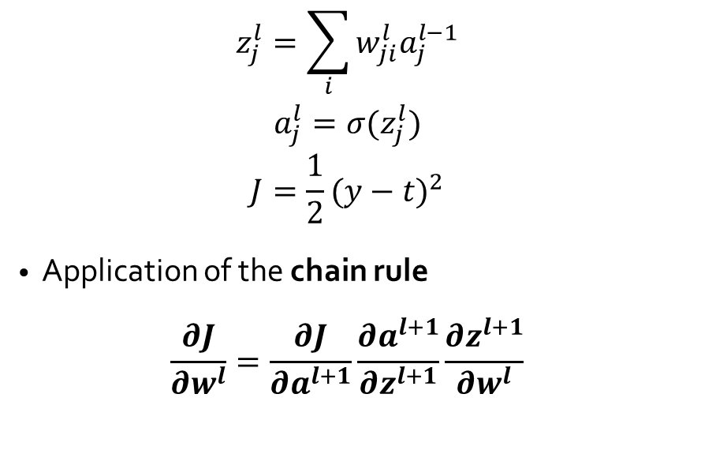
Gradients for hidden layers
$$z_{j}^{l}=\sum_{i}{w_{ji}^{l}a_{j}^{l−1}}$$
$$a_{j}^{l}=σ(z_{j}^{l})$$
$$J=\frac{1}{2}{(y−t)}^{2}$$
Application of the chain rule
$$\frac{∂J}{∂w^{l}}=\frac{∂J}{∂a^{l+1}}\frac{∂a^{l+1}}{∂z^{l+1}}\frac{∂z^{l+1}}{∂w^{l}}$$
x₀
$$a_{0}^{2}$$
$$w_{10}^{2}$$
$$w_{10}^{3}$$
$$w_{20}^{2}$$
x₁
$$w_{11}^{2}$$
$$a_{1}^{2}$$
$$a_{1}^{3}$$
$$w_{11}^{3}$$
$$y$$
$$w_{21}^{2}$$
x₂
$$w_{12}^{2}$$
$$a_{2}^{2}$$
$$w_{12}^{3}$$
$$w_{22}^{2}$$
Updates in layer l depend on the calculations in layer l+1 and the weights in layer l
Input Layer
(layer 1)
Hidden Layer
(layer 2)
Output Layer
(layer 3)

Slide 20
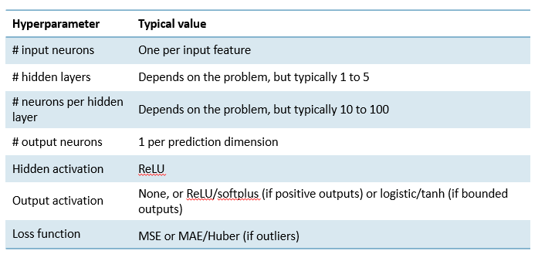
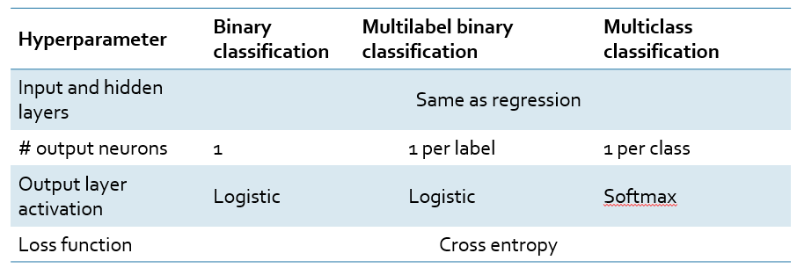
Typical MLP architectures
Regression MLP
Classification MLP
[Hands-On ML, Edition 2 by Aerolien Geron]

